Slide 1
JOIN THE REMIND
Remind code: 489c72f

Slide 2
Hardware presentation
EXTRA LEARNING

Slide 3
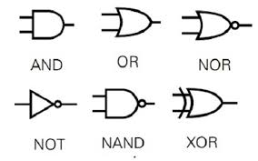
Logic Gates

Slide 4
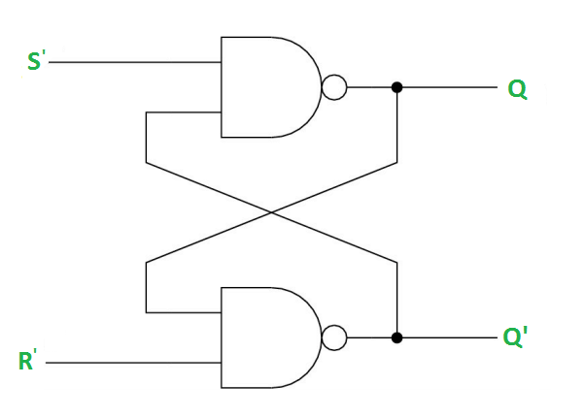
Memory
A latch is a basic way to store a single value.
A latch send its output as its input, allowing the latch to store a bit indefinitely until an outside value is added.
One type of latch is a SR flip flop or a SET, RESET latch . The way it works is that set is 1, and reset is 0, and can be changed by preset(PR) or clear(CLR).
There are a lot more types of latches, such as jk,d,and t types.

Slide 5
Sequential logic
A latch is, by its nature a sequential memory unit. All that means is that it feeds it’s output into its input. This can be considered as reading the previous input and will sometimes be seen as an n-1 input. The routing of this input requires time. Sending the signal is not instant even if it is extremely quick. This creates a challenge when trying to sync up inputs, something you will have to consider.
Flip flops and registers also use sequential logic but circumvent the lining up problem with their added complexity. These memory units are sequential but not all memory is sequential.

Slide 6
Delay
Delay is something you will always have to think about. When you make a circuit there will always be delay and you will always have to think about it.
Writing a value to a circuit takes a little bit of time. It is not instant! The value itself needs to be stable before it can be accepted. This is called setup time.
The signal also needs to be stable enough to be processed. This is called hold time.
Reading a value requires waiting for the signal to be made so that it can be read effectively and the delay of the internal portions of whatever you are reading.
These are only a couple types of delay. There are more complex interpretations and types of delay!

Slide 7
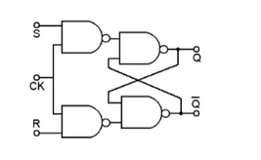
Flip-Flops
A flip-flop is a very very simple memory circuit. Comprised of 4 NAND gates or 4 NOR gates, it hold either a high 1 or a low 0. Only when there is outside power sent to the system will it switch its value.
Flip flops take on the name of the type of latches they use, so if they use an SR latch, then it's an SR flip flop.

Slide 8
Registers
A register is a made of a bunch of latches or flip flops stuck together. The main purpose of a register is to be the fastest form of memory on your computer.
There are a couple of trade offs that a register makes in order to do that. The power of a register is very high for an individual memory unit. Registers come in sizes such as 16, 32, and 64 bits.
Some registers that are stored like this are the program counter, the instruction pointer and stack pointer.
This means that registers are used for fast, temporary storage.

Slide 9
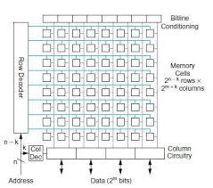
Register files
Along with registers there are also register files. Register files are a collection of registers that are right next to each other.
These collections of memory units are known as memory arrays.
Generally you will see general purpose registers as register files. General purpose registers are registers that are used in regular operations and don't have a special purpose.

Slide 10
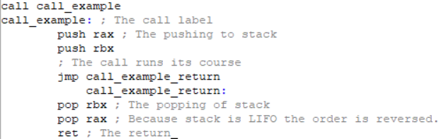
Assembly (For Context)
Assembly is the lowest level of programming language. The primary way you interact with memory in assembly is through register files.

Slide 11
Memory arrays
Memory arrays make up the more complicated memory systems and are the other approach to making memory.
Memory arrays take a memory address and then extract the data from that location. They are made of a bitline and a worldline. The size of these lines are dependent on the specific memory array that is being built.

Slide 12
Primary vs Secondary Memory
Primary - RAM (Random Access Memory)/ ROM (Read only memory), VRAM (GPUs)
Secondary - Storage (SSDs, HDDs, SD Card, Floppy Disk, CD-ROM)?

Slide 13
RAM and ROM
RAM is Random access memory
ROM is Read Only Memory
Both are usually on the motherboard
RAM - DRAM (Dynamics RAM) and SRAM (Static RAM)
RAM is Volatile (Will be lost when the computer is turned off)
RAM is volatile because it is built for speed. Capacitors store the byte values in RAM and must be constantly refreshed.
ROM - PROM (Programmable ROM), EPROM (Erasable ROM), EEPROM (Electronically Erasable ROM) and Flash memory.
ROM is for your BIOS/UEFI

Slide 14
RAM/ROM architecture
RAM is situated on the motherboard and connects to the CPU via a bus.
RAM is made of Memory cells, an address decoder, a write driver, and a
Sense amplifier.
ROM is made of an address decoder and memory cells.
https://www.eeeguide.com/rom-memory/
https://www.researchgate.net/publication/356901190_A_review_paper_on_memory_fault_models_and_test_algorithms

Slide 15
Stack Memory
When a process is allowed to run, it takes up a space on the RAM, within that space is an area called the stack.
The stack is LIFO or Last In First Out.
Think of LIFO as a pancake stack. When you put a pancake onto the stack you store that information on the top of the pile via a push. When you take it off of the stack you take the topmost one via a pop.
What that means is that the stack is a small, fast memory storage system that has to be used in such a way that you know when you are going to need the value of each register.

Slide 16
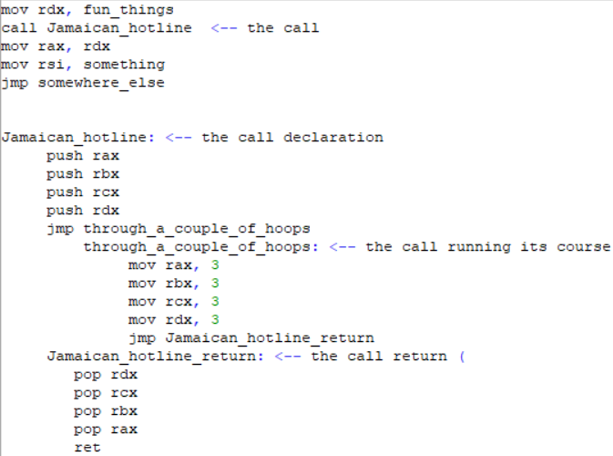
Stack Memory ext.
Everything that is getting pushed or pulled is a register.
rdx is used both in the call and outside of it. The value of rdx is copied onto the stack when rdx is pushed onto the stack.
rdx is being modified and changed so the value of rdx is not the same as rdx was before the call executed (on line 2).

Slide 17
Stack Memory ext.
Calls are not the only use case for stack. Besides calls, the stack is used whenever you want to save the value of a something (It can be a register or a variable). Remember that when you store something on the stack, it will be at the very top
That means that you have to set it up to be the only value that is pushed or that the values that you pushed after pushing your initial value will be popped beforehand.

Slide 18
Stack vs Heap
The heap is different from the stack, the stack has a fixed size on the RAM, imagine a little box that you can stack plates in, it's still LIFO, but only to a certain extent.
The heap can dynamically shift from size to size on the RAM depending on what is needed.
When using the heap, data is put on kinda like the stack, where its in a more organized fashion, but the heap is NOT LIFO, meaning any data can be removed and accessed at anytime, making it very UNorganized and when trying to use it, unpredictable. This is called fragmentation.

Slide 19
Flash Memory
NOR vs NAND flash memory.
Pin count is a major factor when deciding whether NOR or NAND is used.
NAND is more efficient than efficient.
Both types of flash can be serial and parallel.
Both of these behave like their respective gates. They are not made up of their respective gates.

Slide 20
Cache
XiP is not always possible and reading from storage is not efficient. A common tactic is moving a copy of the information that is needed. That is done with the cache.
The cache is made up of 3 levels. The first level L1, is the closest to the datapath and is the fastest. L2 and L3 are bigger and slower.

